Slide 1
Pair selection for view invariance in siamese network
Yu-Cheng Lin and Wei-Chih Chen
Advised by Yong Jae Lee

Slide 2
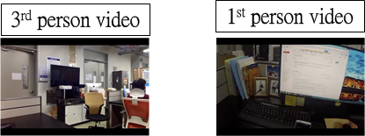
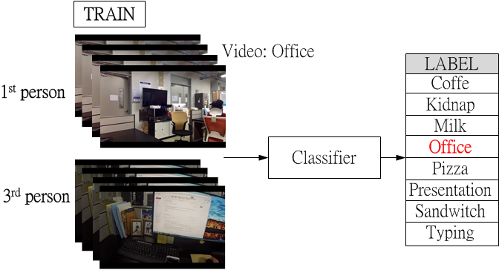
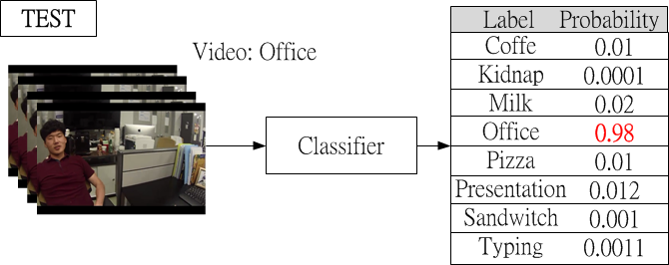
Introduction
Project goal: first person video classification.

Slide 3
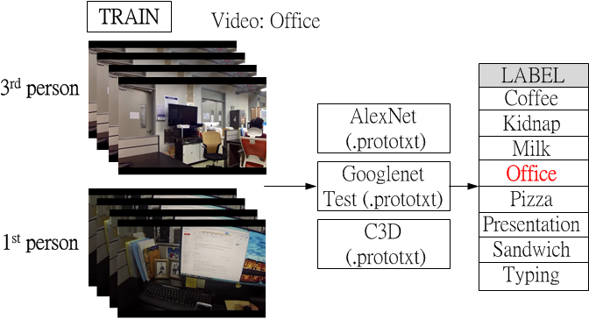
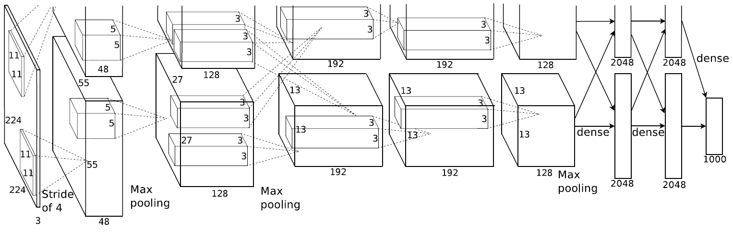
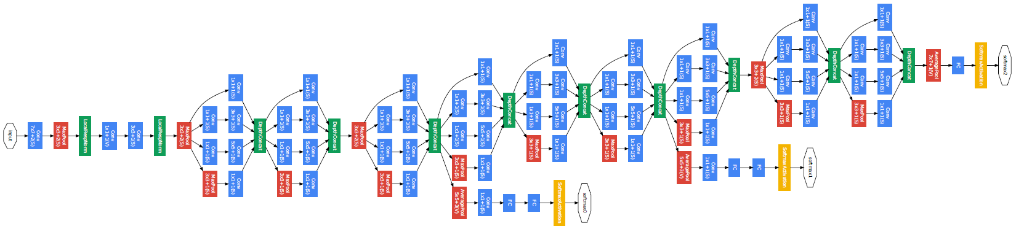
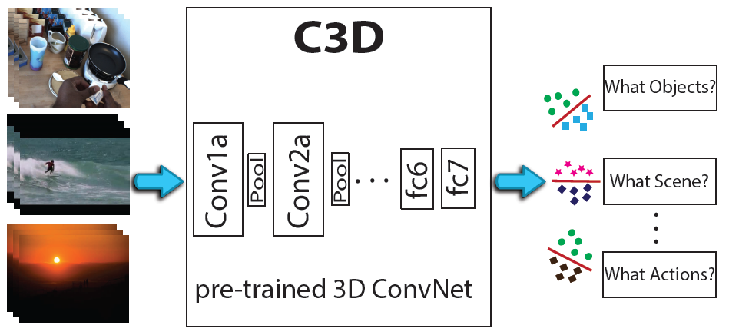
Introduction
Project separate into two stage.
First stage: Build baseline on exist network
Second stage: Propose a new network to improve performance

Slide 4
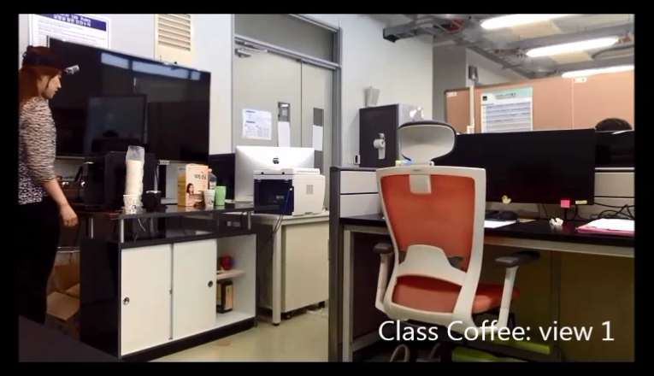

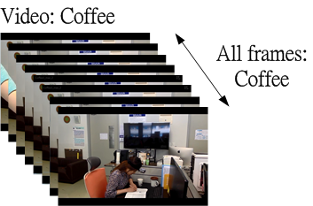
Dataset (1/2)
Label | Class | Video number
0 | Coffe | 18
1 | Kidnap | 56
2 | Milk | 3
3 | Office | 59
4 | Pizza | 15
5 | Presentation | 18
6 | Sandwitch | 13
7 | Typing | 9
 | Total | 191
Each scene took from 2 still cameras in different positions and 1 GoPro.
(From Indiana University)

Slide 5
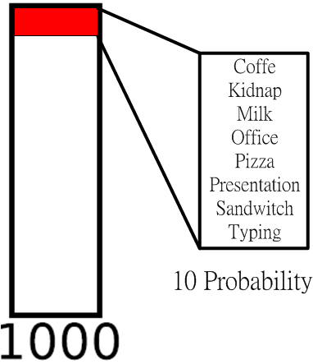
Dataset (2/2)
Using Caffe library (written in C++ )
Running on Linux
Each video ~4K frames with sample rate 1/10
Train : Test = 3 : 1
Googlenet fine-tune 170k iterations takes 36 hours

Slide 6
Result(2/2)
Based on iterations 20K
total | correct videos | video counts | accuracy
C3D | 25 | 33 | 0.7575
Alexnet | 34 | 50 | 0.68
Googlenet | 34 | 50 | 0.68
label type | Networks | Misclassify label
Coffee | Alexnet | 3 labeled as kidnap, 3 labeled as office
 | Googlenet | 2 labeled as kidnap, 4 labeled as office
Kidnap | C3D | all labeled as office
 | Alexnet | all labeled as office
 | Googlenet | all labeled as office
Office | C3D | all labelled as kidnap
Sandwich | Alexnet | all labeled as pizza
 | Googlenet | all labeled as pizza

Slide 7
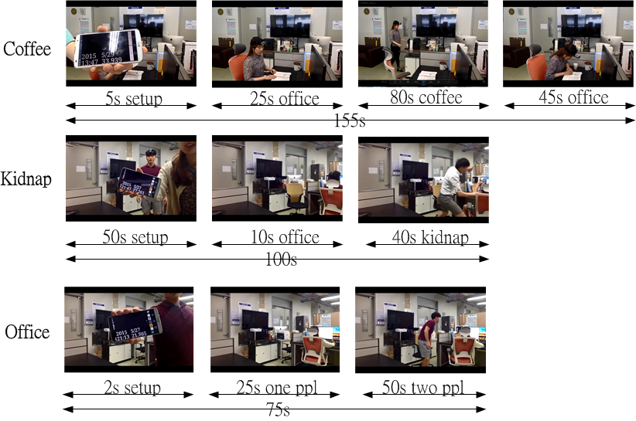
Analysis(1/2)
label type | Networks | Misclassify label
Coffee | Alexnet | 3 labeled as kidnap, 3 labeled as office
 | Googlenet | 2 labeled as kidnap, 4 labeled as office
Kidnap | C3D | all labeled as office
 | Alexnet | all labeled as office
 | Googlenet | all labeled as office

Slide 8
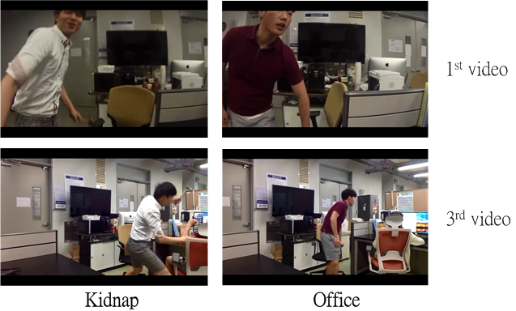
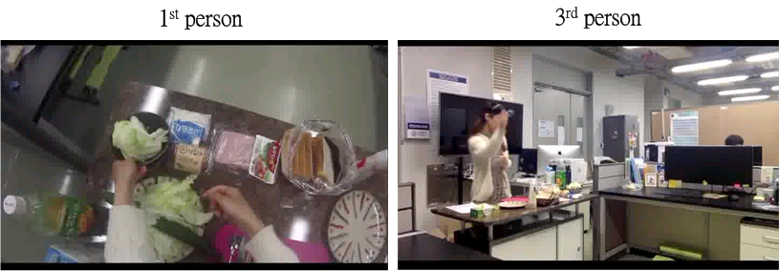
Analysis(2/2)
Network cannot tell:
Learn features from 3rd person video and relate these features with features from 1st person video.

Slide 9
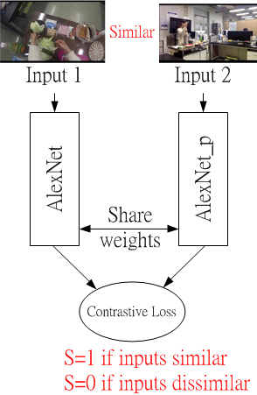
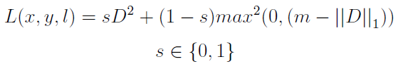
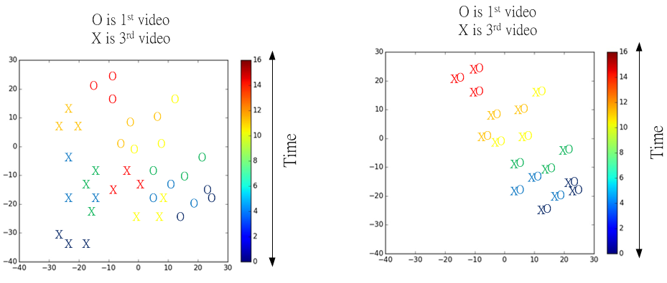
Proposed network - siamese network
Contrastive Loss: To learn features from two inputs.
Idea t-SNE

Slide 10
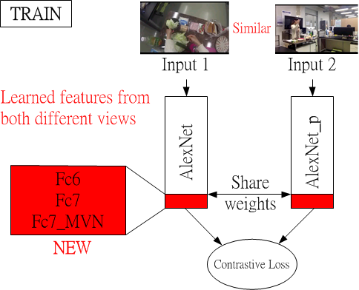
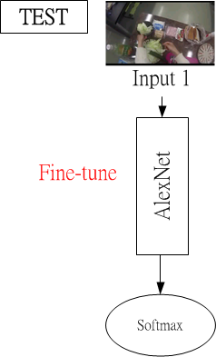
Proposed network - siamese network

Slide 11
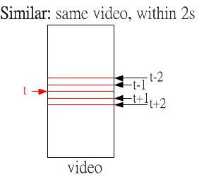
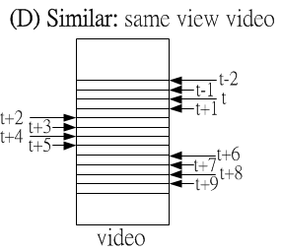
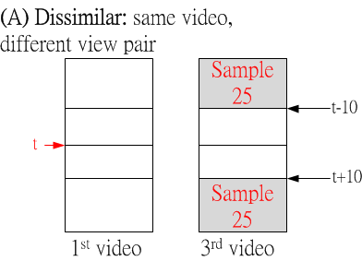
Define similar and dissimilar(1/2)
Similar : Dissimilar = 1:20

Slide 12
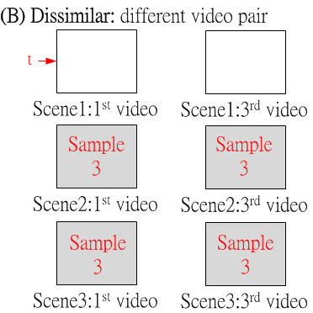
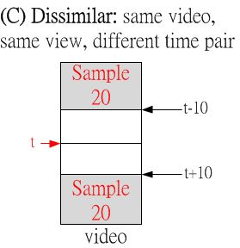
Define similar and dissimilar(2/2)

Slide 13
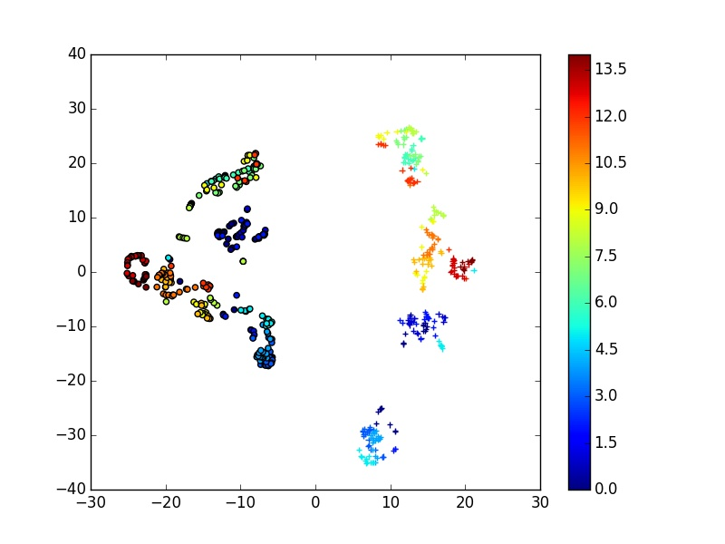
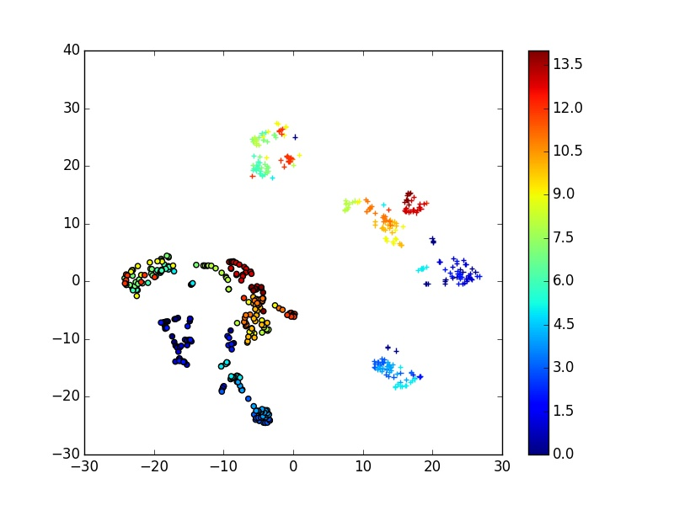
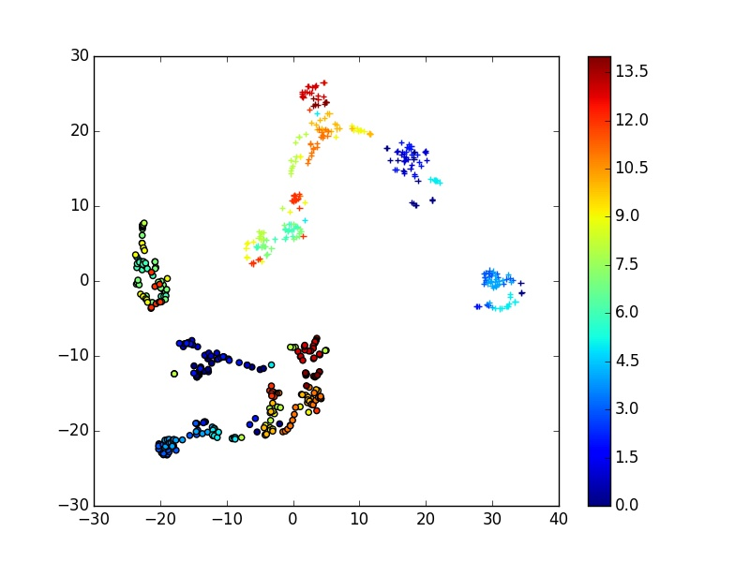
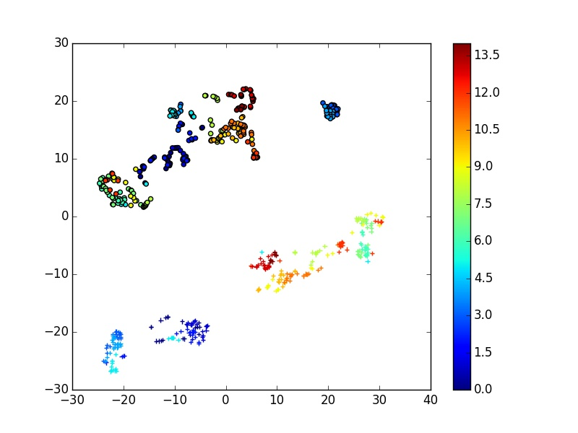
Experimental Results (Sand1)
Exp1/2/3/4: iter=27.5K/30K/40K/40K (epoch=93.46/97.86/88.84/86.47)
Legends: “o”: gopro, “+”: mac1
Color: Blue: start frames, Red: end frames
Exp4 is better

Slide 14
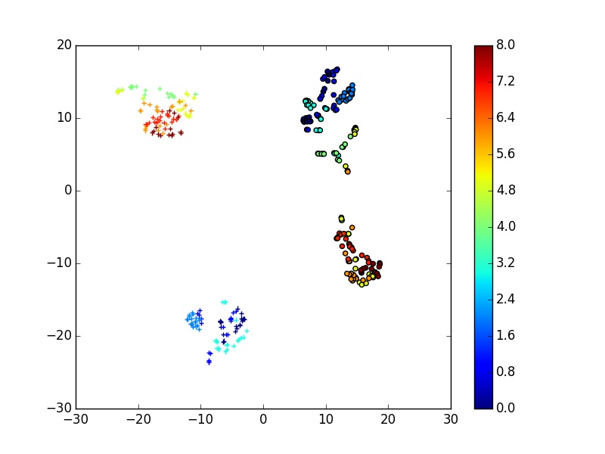
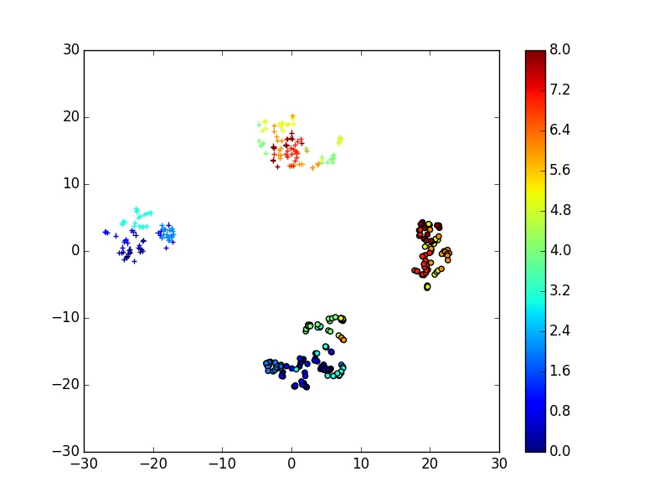
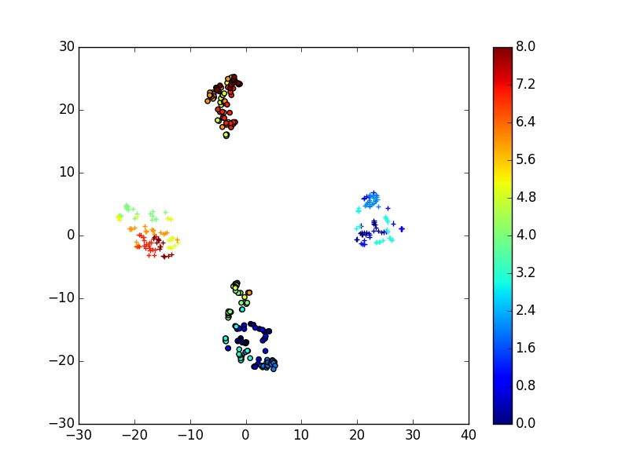
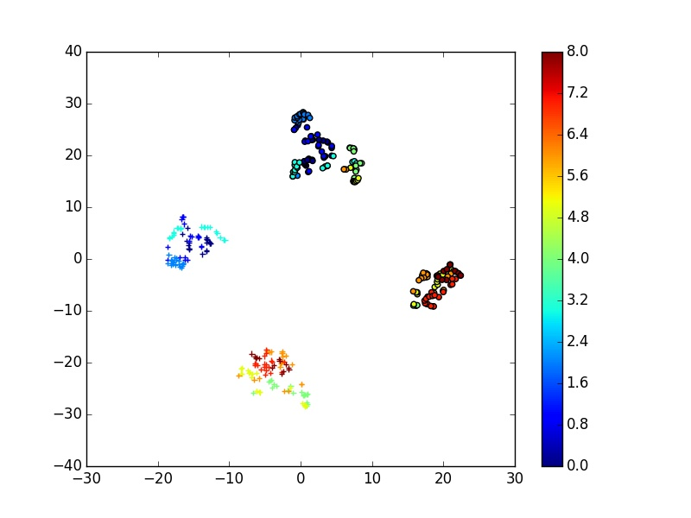
Experimental Results (Sand2)
Exp1/2/3/4: iter=27.5K/30K/40K/40K (epoch=93.46/97.86/88.84/86.47)
Legends: “o”: gopro, “+”: mac1
Color: Blue: start frames, Red: end frames
Exp4 and exp2 are better

Slide 15
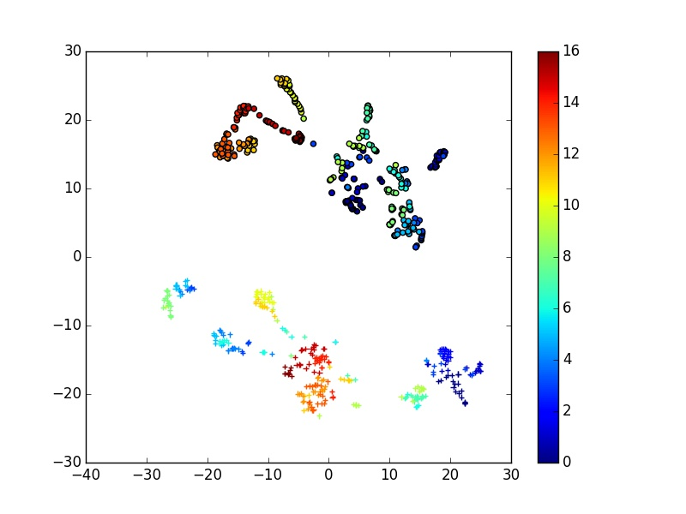
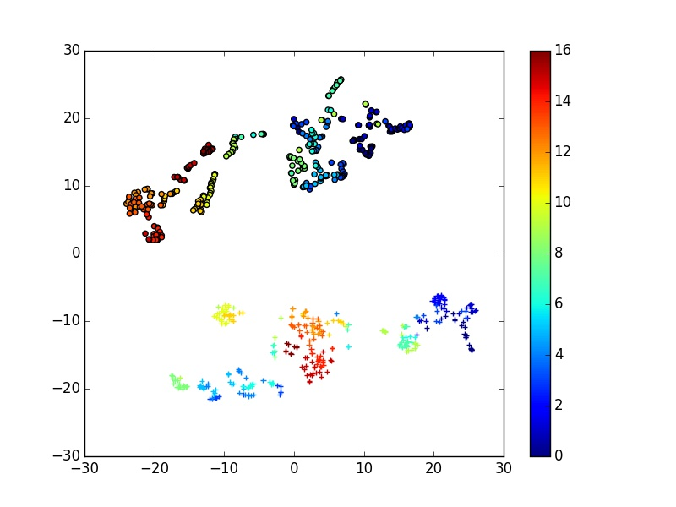
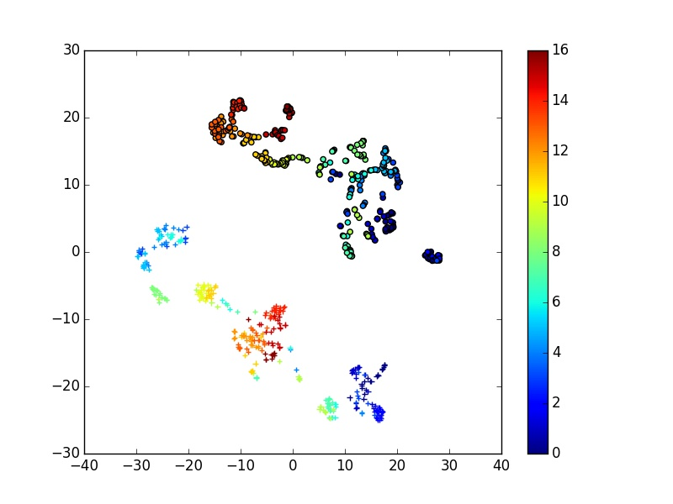
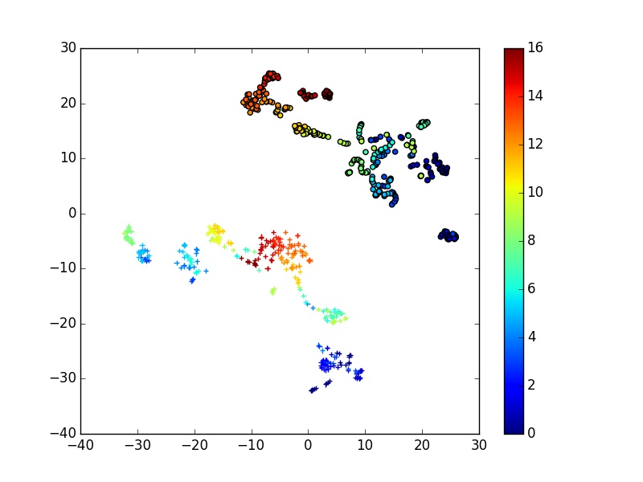
Experimental Results (Sand3)
Exp1/2/3/4: iter=27.5K/30K/40K/40K (epoch=93.46/97.86/88.84/86.47)
Legends: “o”: gopro, “+”: mac1
Color: Blue: start frames, Red: end frames
Exp2 is better

Slide 16
Conclusion
(A) dissimilar: same video, different view pair
(B) dissimilar: different video pair
(C) dissimilar: same video, same view, different time pair
(D) similar: same view video
1. (A)(C)
2. (A)(C)(D)
3. (A)(B)(C)
4. (A)(B)(C)(D)
Exp2 and exp4 are overall better.
(D) Similar pair compensation is crucial
(B) is covered by classification training
Exp2 setting is hence preferable

Slide 17
Future Work
Use optical flow to capture motion information for siamese network
a. 5-channel input frame (R, G, B, dx, dy)
Train with same pair selection criteria for all video classes
Fine-tune on this pre-trained siamese network for video classification

